Slide 1
Title of Presentation
Presenter’s Name
Presenter’s Job Title
Company or Organization
ISSM Area – Number (eg., FM-999)
E-mail Address
Notes:
Title Slide
If your Presentation Title is very long you may need to use plain text instead of bold or modify the font size to fit.

Slide 2
ISSM PPT Template
For Oral Speaker,
Use this template to develop your presentation for ISSM.
Each oral session speaker is allowed 15 minutes, followed by a 5-minute question and answer period.
Limit your presentation to a maximum of 10 slides, including the title slide.
Keep it simple!

Slide 3
Slide Guidelines
Slides should emphasize key points
- Limit to 7 lines per slide
- Limit to 7-9 words per line
Maximum number of slides 10
Slides must be in landscape format only
Bullets are created automatically
Examples of various slide types follow. . .

Slide 4
Title Text
Font, size, and color for text have all been formatted in the Slide Master. All text is Arial font.
First level bullet text
  Second level bullet text
    Third level bullet text

Slide 5
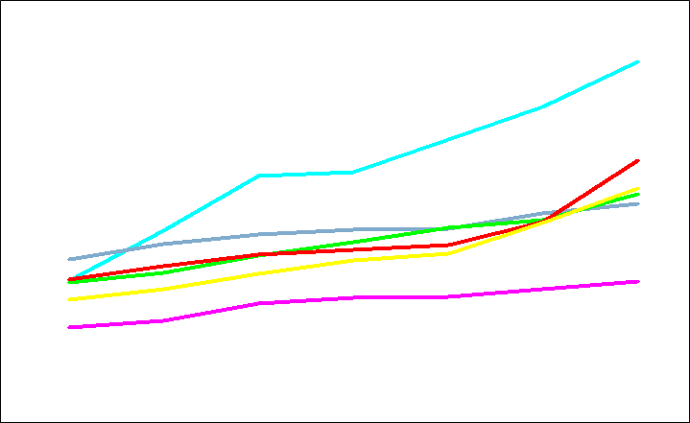
Line Plot Example
Callouts*
Callouts
* Any Notes
Notes:
Line graph showing recommended color palette.
Graph callouts are Arial bold.
Tick marks on vertical and horizontal axis appear to the outside of the axis only.
Line thickness for data should be the thickest available in the graphing program.
Footnotes are 16pt. Arial bold and align flush right.
When possible use MS Graph as opposed to Excel for compatibility
If using Excel, ungroup the charts convert to ppt objects and re-adjust the colors and fonts
Use a minimum of high resolution bitmaps or screen captions

Slide 6
Column Graph Example
Units Shipped
Notes:
Column graph.
Column and bar graphs should always be two dimensional. Three dimensional graphs, although sometimes attractive, tend to make it harder for your audience to quickly comprehend the data being presented.
Note: No tick marks are used on the horizontal axis on column graphs.
Financial data should always be depicted in green. (Red for negative data points.)

Slide 7
Pie Chart Example

Slide 8
When Finished
Proofread -- have a colleague review your.
Practice your presentation in slide show mode. Correct as needed.

